Slide 1

EMPLOYEE RETENTION
Group - 1

Slide 2
Group Members – Kunal Prathap Apurva Vedant Baibhab Manish

Slide 3
Agenda
Introduction
Problem
Statement
Approach
Results
Conclusions
Presentation Title

Slide 4

Introduction
HR Analytics
- Employee Retention :
In today's competitive business, retaining talented employees is essential for organizational success. As such, our project aims to leverage HR analytics to gain valuable insights into employee retention.

Slide 5


Slide 6
Problem Statement :
Despite efforts to recruit and retain talent, the organization is experiencing a significant attrition rate across various departments. Understanding why employees are leaving is challenging, making it difficult to implement effective retention strategies. The goal is to analyze HR data to uncover reasons for attrition, enabling the development of targeted solutions to improve employee retention and overall organizational stability.

Slide 7


Reduce Attrition
Fair Compensation
Improve Work-Life Balance
Increase Tenure
Career Progression
Data-Driven Decisions
Business objective

Slide 8


Slide 9
Project flow can be defined by the following steps :
Data Cleaning/Merging in Excel
Dashboard Creation in Excel
Dashboard Creation in Power BI
Dashboard Creation in Tableau
KPI Validation with SQL Queries
Key Insights

Slide 10


Slide 11
TOP KPI ‘S USED
Average Attrition rate per all the department
Average Hourly Rate as per Job Role
Percentage Of Attrition as per Gender and Age category
Attrition count as per Job Role
Salary Hike as per Age and Attrition

Slide 12
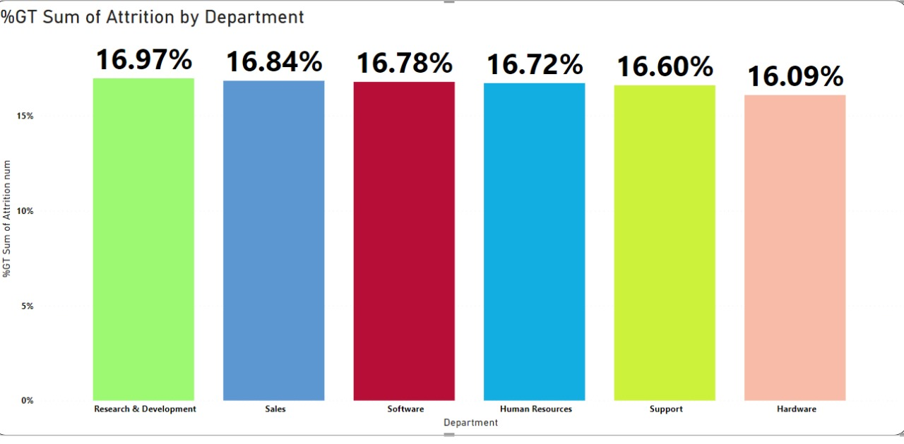
In Following it is mentioned attrition as per department. As you can see following are top 5 Departments as per there attrition rates. The top one is in Research and Development(R&D) Departments with 16.97%, and Lowest is in Hardware with 16.09%
KPI 1 :Average Attrition Rate Per All The Department

Slide 13
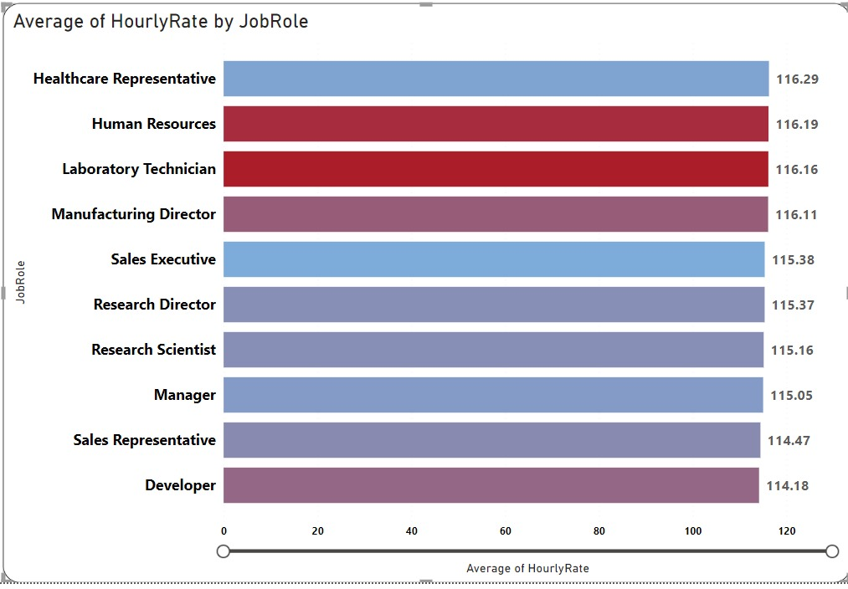
The Second KPI explains which job role have more workload and which department has higher working rate and which has lowest. As per Dashboard created we found that Healthcare department has higher working rate and on other hand developer work on 11.18 hours only.
KPI 2 : Average Hourly Rate As Per Job Role

Slide 14
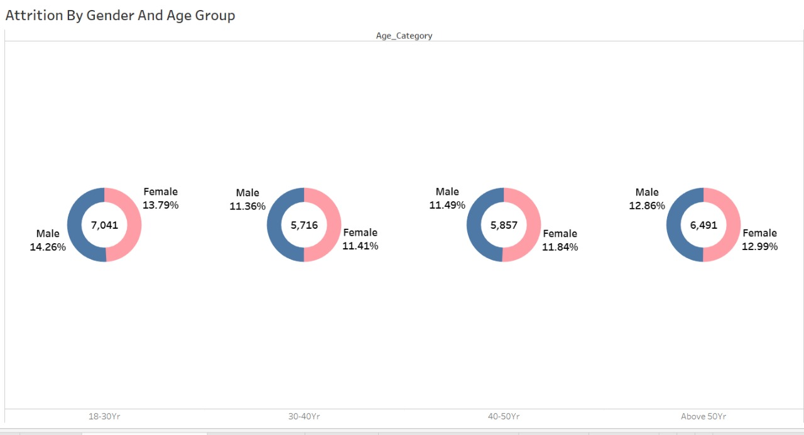
Attrition Rate is also calculate on the basis of age of the employees. Following Diagram used in shows the attrition rate as per different age category and gender wise bifurcation. The highest rate is in age of 18 to 30 years – out of which 14.26 % are male and female are 13.79%. Followed by Age above 50 years.
KPI 3: Attrition As Per Age And Gender

Slide 15
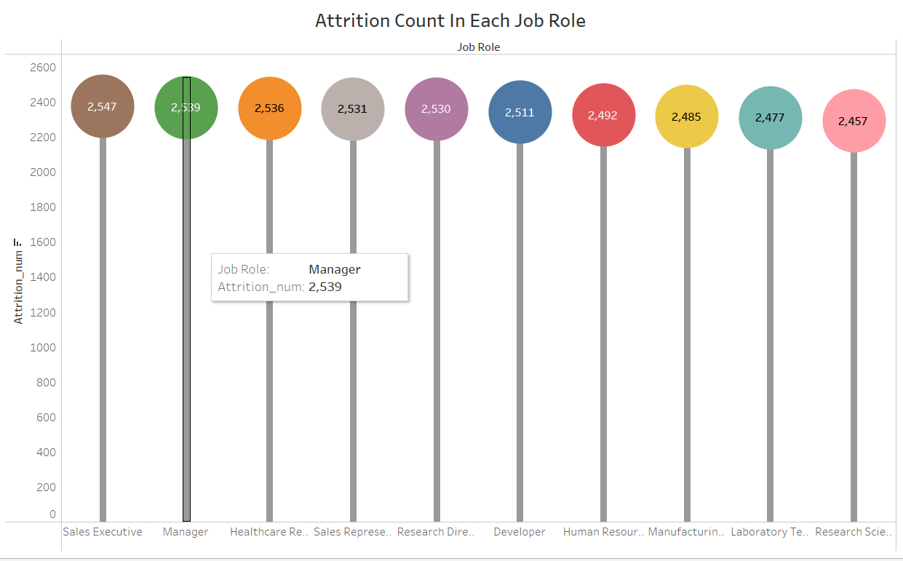
Attrition Count As Per Job Role
Attrition count by job role tracks how many employees leave specific positions in a company.
It helps identify turnover trends in different roles, pinpointing areas needing improvement like job satisfaction or growth opportunities. By focusing on attrition by job role.
3. As Discussed above, The Attrition count with Executive Job Role is the highest – 2547 and With Research Scientist is the Lowest - 2457

Slide 16
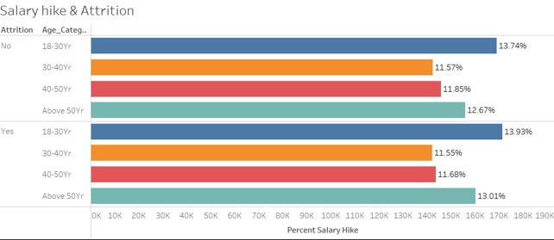
To decrease the Attrition rate Salary Hike plays an important role. Following is data sets which shows which age category is given more hike as per their need and importance in the company. The highest salary hike is given to Age 18 to 30 years which hike rate of 13.93%.
KPI 5: Salary Hike As Per Age And Attrition.

Slide 17
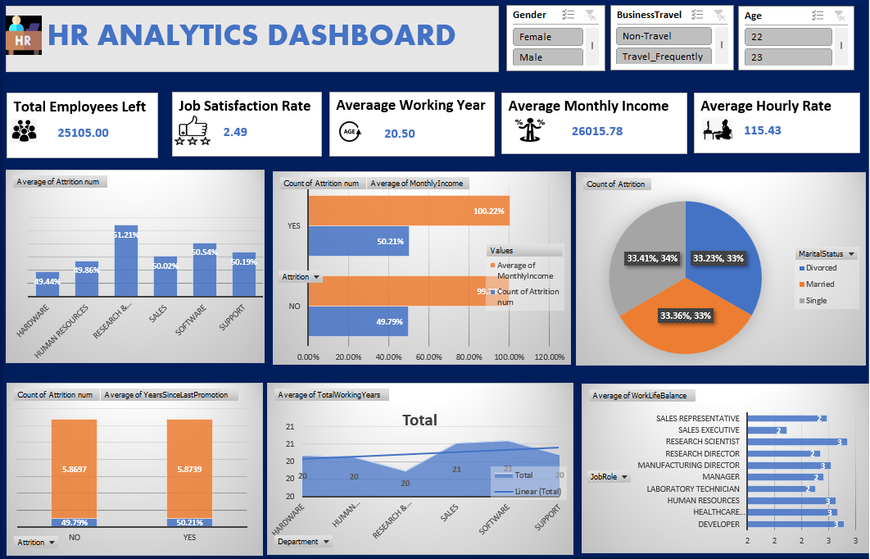
Dashboard In Excel

Slide 18
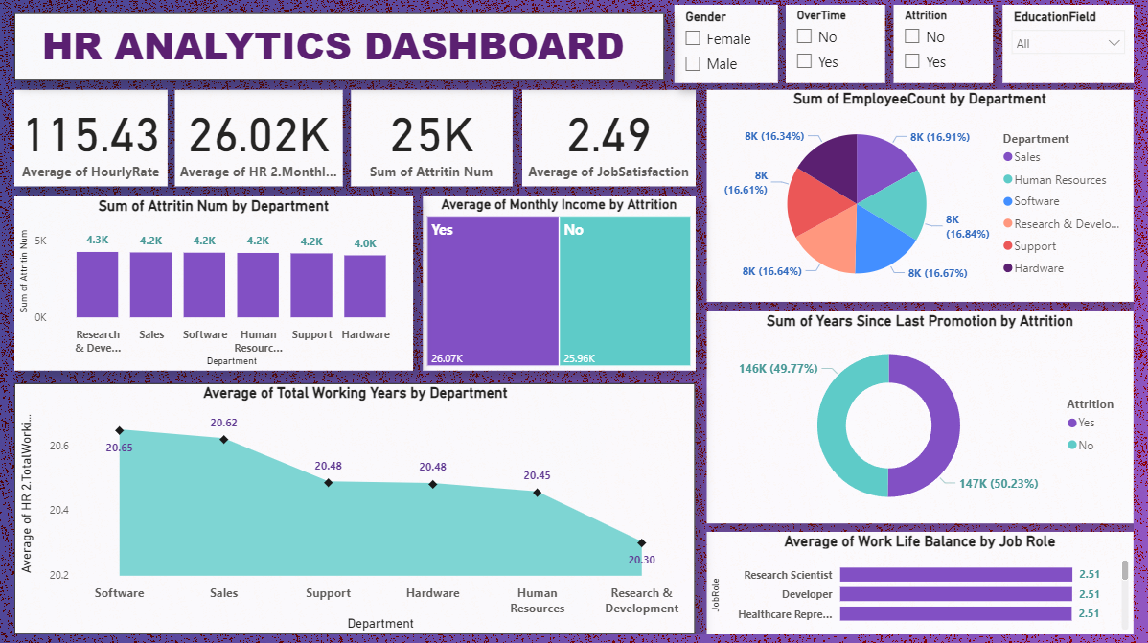
Dashboard In Power Bi

Slide 19
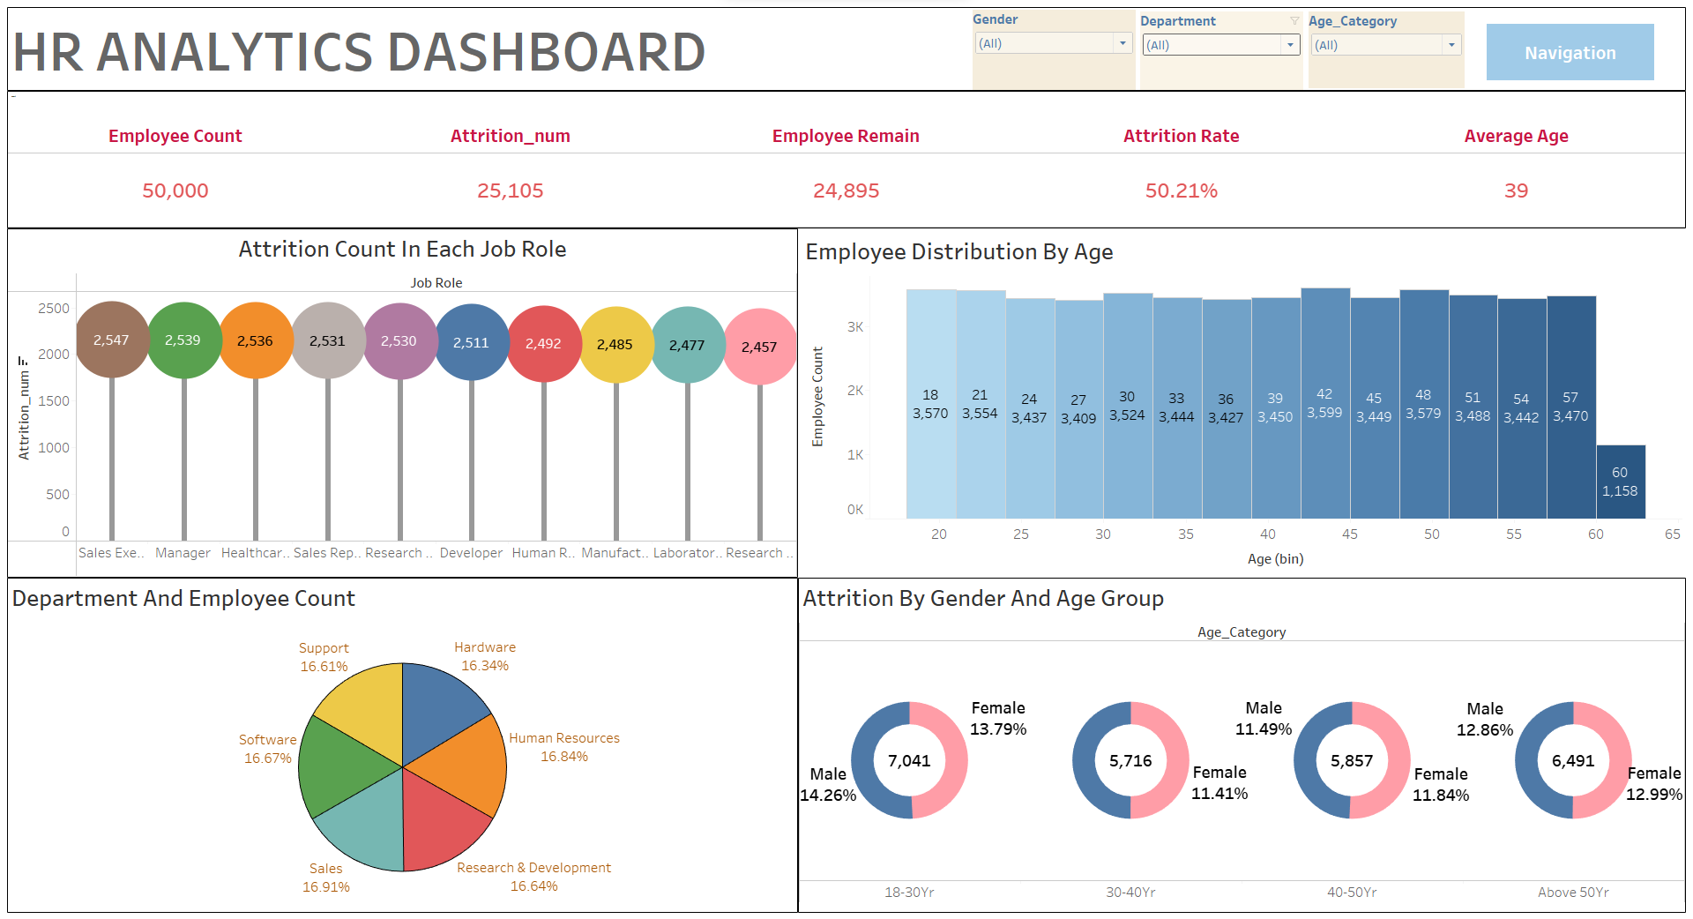
Dashboard In Tableau

Slide 20
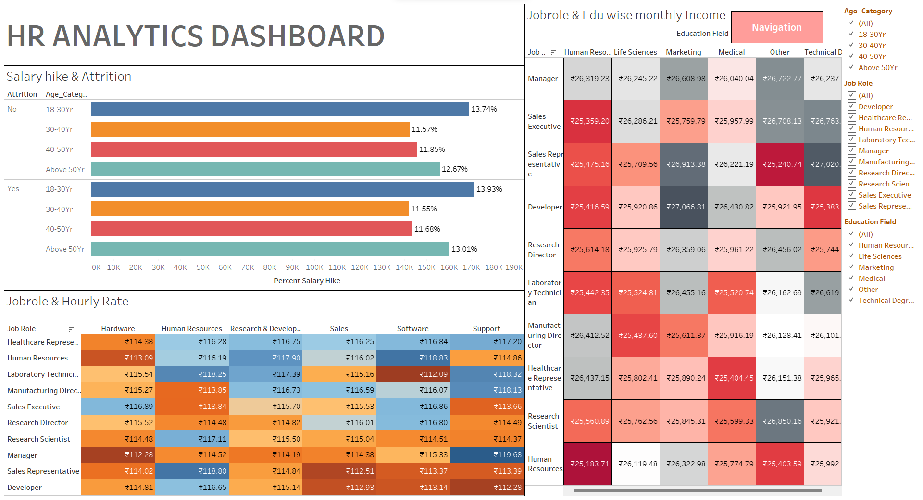

Slide 21
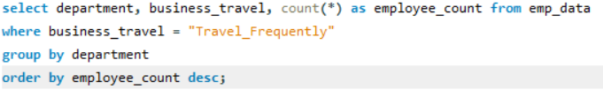
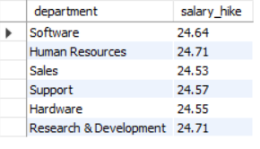
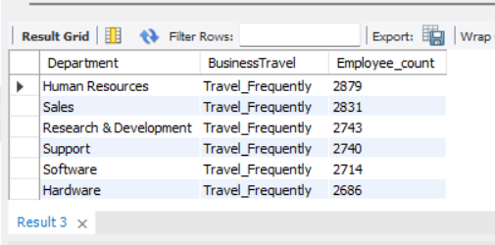
SQL Queries
Depts getting Avg. 24% salary hike
No of Employees that travel often

Slide 22
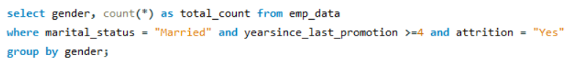
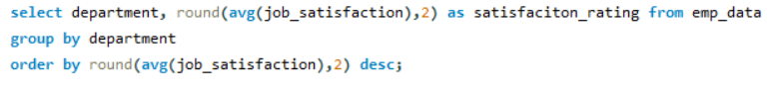
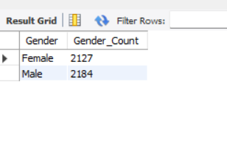
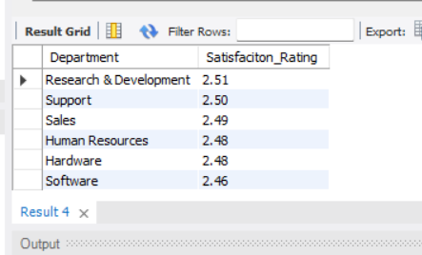
Married Gender count not promoted for last 4 years
Department wise Job Satisfaction
Rating

Slide 23


Slide 24

Key Findings
Average hourly rate of both male and female Research Scientists is approximately same.
There is near about 50% attribution rate in all the departments.
People who left the organization wasn’t not promoted from average past 6 years.
Research Scientists have very good life balance while Sales Executives are overwhelmed.
Average people who left the organization had more salary than those people.

Slide 25




Thank You

